Slide 1


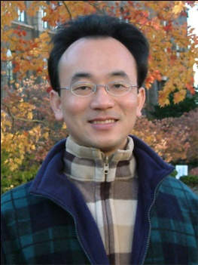
人工智慧於口腔健康應用 (Artificial Intelligence in Oral Health Applications)
臺北醫學大學 口腔衛生學系 人工智慧講座
Host: Prof. Li Sheng Chen School of Oral Hygiene, Taipei Medical University
Time: 15:10-17:00, Nov 23, 2020 (Monday)
Place: 口腔3樓會議室, TMU
Address: N250 Wu-Hsing Street, Taipei, Taiwan
Min-Yuh Day
戴敏育
Associate Professor
副教授
Institute of Information Management, National Taipei University
國立臺北大學 資訊管理研究所
https://web.ntpu.edu.tw/~myday
2020-11-23

Slide 2



戴敏育 博士 (Min-Yuh Day, Ph.D.)
國立台北大學 資訊管理研究所 副教授
中央研究院 資訊科學研究所 訪問學人
國立台灣大學 資訊管理 博士
Publications Co-Chairs, IEEE/ACM International Conference on Advances in Social Networks Analysis and Mining (ASONAM 2013- )
Program Co-Chair, IEEE International Workshop on Empirical Methods for Recognizing Inference in TExt (IEEE EM-RITE 2012- )
Publications Chair, The IEEE International Conference on Information Reuse and Integration (IEEE IRI)

Slide 3
Outline
Artificial Intelligence
Machine Learning
Deep Learning
AI in Oral Health Applications

Slide 4
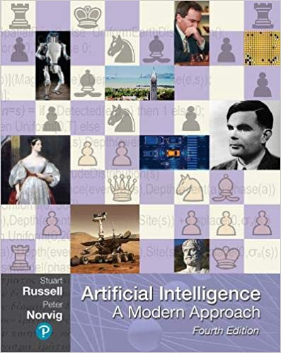
Stuart Russell and Peter Norvig (2020), Artificial Intelligence: A Modern Approach, 4th Edition, Pearson
Source: Stuart Russell and Peter Norvig (2020), Artificial Intelligence: A Modern Approach, 4th Edition, Pearson
https://www.amazon.com/Artificial-Intelligence-A-Modern-Approach/dp/0134610997/

Slide 5
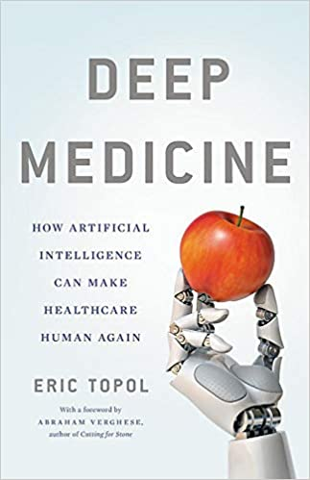
Eric Topol (2019), Deep Medicine: How Artificial Intelligence Can Make Healthcare Human Again, Basic Books
Source: Eric Topol (2019), Deep Medicine: How Artificial Intelligence Can Make Healthcare Human Again, Basic Books
https://www.amazon.com/Deep-Medicine-Artificial-Intelligence-Healthcare/dp/1541644638/

Slide 6
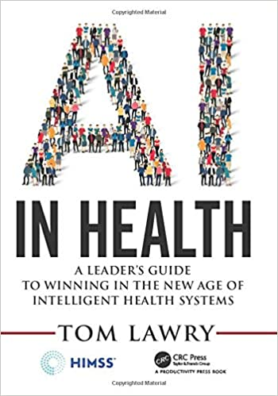
Tom Lawry (2020), AI in Health: A Leader’s Guide to Winning in the New Age of Intelligent Health Systems, HIMSS Publishing
Source: Tom Lawry (2020), AI in Health: A Leader’s Guide to Winning in the New Age of Intelligent Health Systems, HIMSS Publishing
https://www.amazon.com/Health-HIMSS-Book-Tom-Lawry/dp/0367333716/

Slide 7
AI, Big Data, Cloud Computing Evolution of Decision Support, Business Intelligence, and Analytics
AI
AI
Cloud Computing
Big Data
DM
BI
Source: Ramesh Sharda, Dursun Delen, and Efraim Turban (2017), Business Intelligence, Analytics, and Data Science: A Managerial Perspective, 4th Edition, Pearson

Slide 8
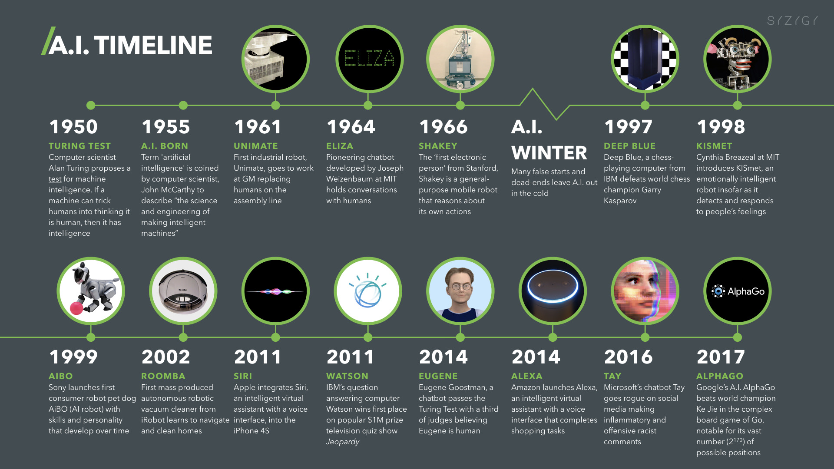
Artificial Intelligence (A.I.) Timeline
Source: https://digitalintelligencetoday.com/artificial-intelligence-timeline-infographic-from-eliza-to-tay-and-beyond/

Slide 9
The Rise of AI
Source: DHL (2018), Artificial Intelligence in Logistics, http://www.globalhha.com/doclib/data/upload/doc_con/5e50c53c5bf67.pdf/

Slide 10
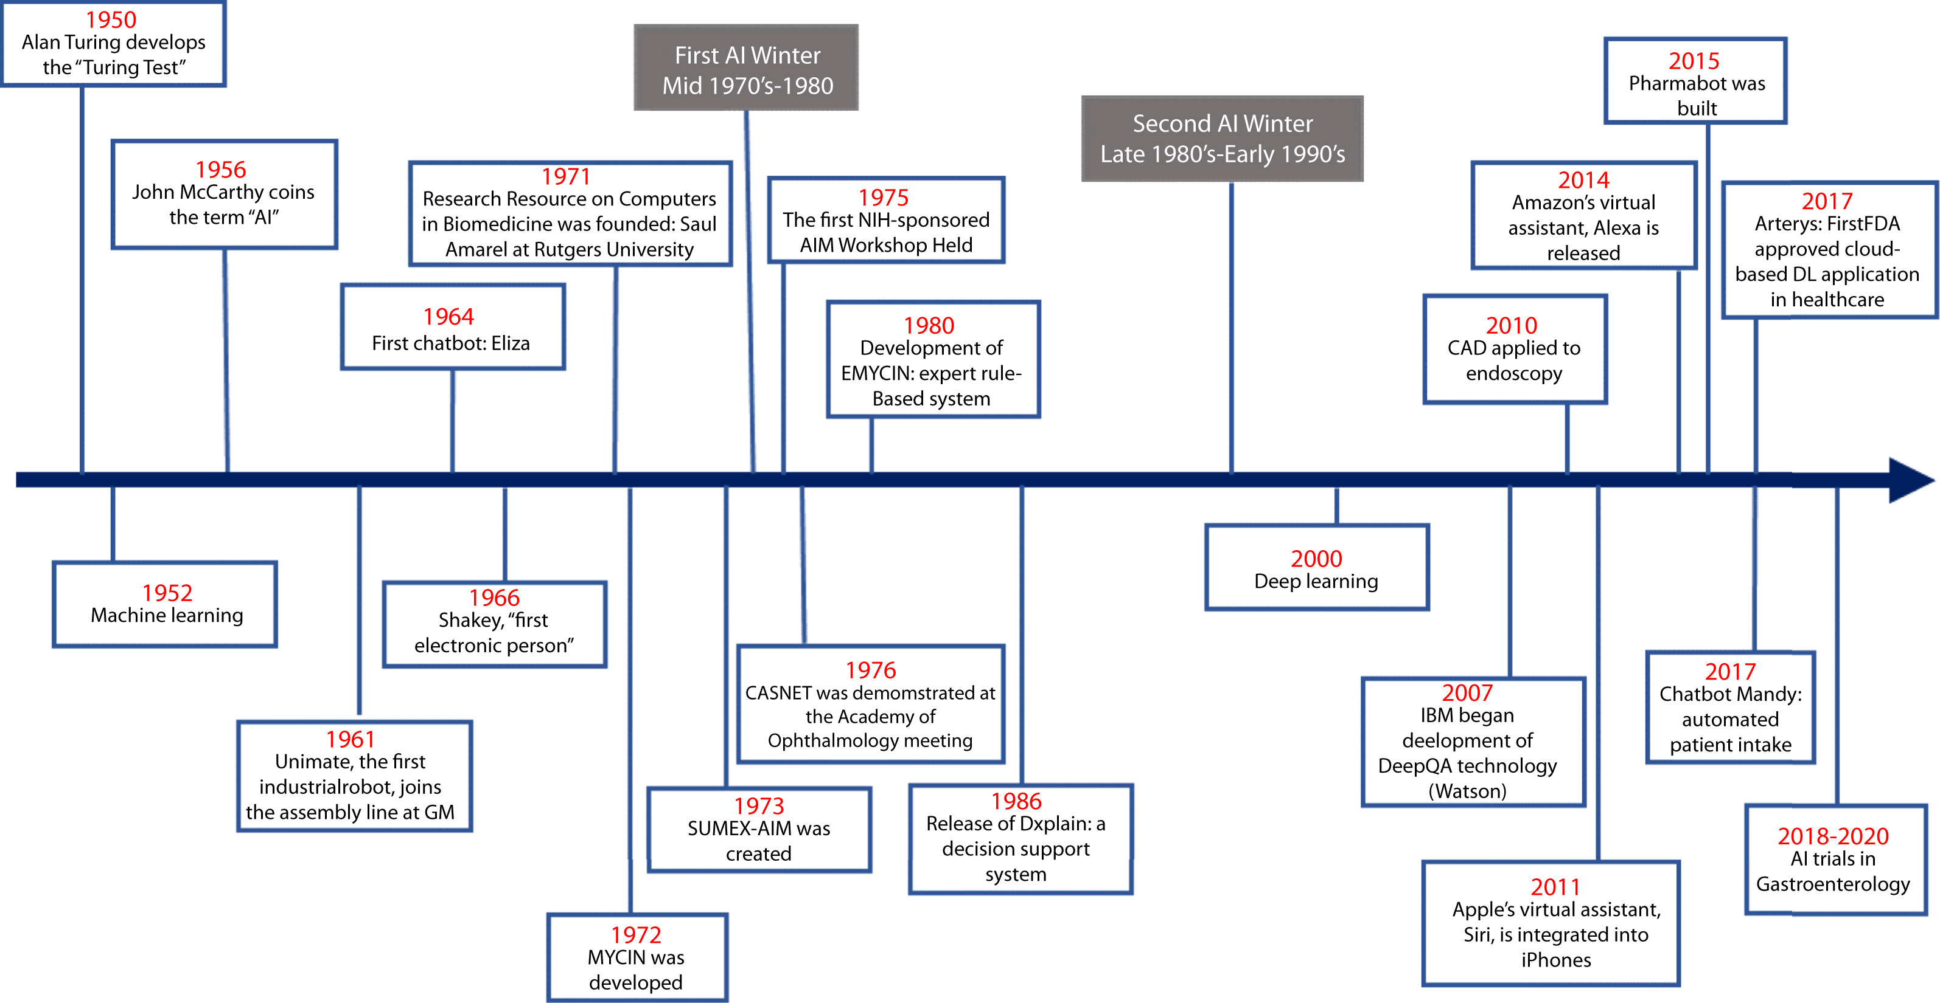
Artificial Intelligence in Medicine
Source: Vivek Kaul, Sarah Enslin, and Seth A. Gross (2020), "The history of artificial intelligence in medicine." Gastrointestinal endoscopy..

Slide 11
AI

Slide 12
Definition of Artificial Intelligence (A.I.)

Slide 13
Artificial Intelligence “… the science and engineering of making intelligent machines” (John McCarthy, 1955)
Source: https://digitalintelligencetoday.com/artificial-intelligence-defined-useful-list-of-popular-definitions-from-business-and-science/

Slide 14
Artificial Intelligence “… technology that thinks and acts like humans”
Source: https://digitalintelligencetoday.com/artificial-intelligence-defined-useful-list-of-popular-definitions-from-business-and-science/

Slide 15
Artificial Intelligence “… intelligence exhibited by machines or software”
Source: https://digitalintelligencetoday.com/artificial-intelligence-defined-useful-list-of-popular-definitions-from-business-and-science/

Slide 16
4 Approaches of AI
Thinking Humanly | Thinking Rationally
Acting Humanly | Acting Rationally
Source: Stuart Russell and Peter Norvig (2020), Artificial Intelligence: A Modern Approach, 4th Edition, Pearson

Slide 17
4 Approaches of AI
2. Thinking Humanly: The Cognitive Modeling Approach | 3. Thinking Rationally: The “Laws of Thought” Approach
1. Acting Humanly: The Turing Test Approach (1950) | 4. Acting Rationally: The Rational Agent Approach
Source: Stuart Russell and Peter Norvig (2020), Artificial Intelligence: A Modern Approach, 4th Edition, Pearson

Slide 18
AI Acting Humanly: The Turing Test Approach (Alan Turing, 1950)
Knowledge Representation
Automated Reasoning
Machine Learning (ML)
Deep Learning (DL)
Computer Vision (Image, Video)
Natural Language Processing (NLP)
Robotics
Source: Stuart Russell and Peter Norvig (2020), Artificial Intelligence: A Modern Approach, 4th Edition, Pearson

Slide 19
Artificial Intelligence: A Modern Approach
Artificial Intelligence
Problem Solving
Knowledge and Reasoning
Uncertain Knowledge and Reasoning
Learning
Communicating, Perceiving, and Acting
Philosophy and Ethics of AI
Source: Stuart Russell and Peter Norvig (2020), Artificial Intelligence: A Modern Approach, 4th Edition, Pearson

Slide 20
Artificial Intelligence: 5. Learning
Multiagent Decision Making
Learning from Examples
Learning Probabilistic Models
Deep Learning
Source: Stuart Russell and Peter Norvig (2020), Artificial Intelligence: A Modern Approach, 4th Edition, Pearson

Slide 21
Artificial Intelligence: 6. Communicating, Perceiving, and Acting
Reinforcement Learning
Natural Language Processing
Deep Learning for Natural Language Processing
Robotics
Source: Stuart Russell and Peter Norvig (2020), Artificial Intelligence: A Modern Approach, 4th Edition, Pearson

Slide 22
AI in Medicine
AI algorithms now equal or exceed expert doctors at diagnosing many conditions, particularly when the diagnosis is based on images.
Examples:
Alzheimer’s disease (Ding et al., 2018)
Metastatic cancer (Liu et al., 2017; Esteva et al., 2017)
Ophthalmic disease (Gulshan et al., 2016)
Skin diseases (Liu et al., 2019c)
Source: Stuart Russell and Peter Norvig (2020), Artificial Intelligence: A Modern Approach, 4th Edition, Pearson

Slide 23
AI in Medicine
A systematic review and meta-analysis (Liu et al., 2019a) found that the performance of AI programs, on average, was equivalent to health care professionals.
One current emphasis in medical AI is in facilitating human–machine partnerships.
For example, the LYNA system achieves 99.6% overall accuracy in diagnosing metastatic breast cancer—better than an unaided human expert—but the combination does better still (Liu et al., 2018; Steiner et al., 2018)..
Source: Stuart Russell and Peter Norvig (2020), Artificial Intelligence: A Modern Approach, 4th Edition, Pearson

Slide 24
AI in Medicine
The widespread adoption of these techniques is now limited not by diagnostic accuracy but by the need to demonstrate improvement in clinical outcomes and to ensure transparency, lack of bias, and data privacy (Topol, 2019).
In 2017, only two medical AI applications were approved by the FDA, but that increased to 12 in 2018, and continues to rise.
Source: Stuart Russell and Peter Norvig (2020), Artificial Intelligence: A Modern Approach, 4th Edition, Pearson

Slide 25
3 Machine Learning Algorithms
Source: Enrico Galimberti, http://blogs.teradata.com/data-points/tree-machine-learning-algorithms/

Slide 26
Artificial Intelligence Machine Learning & Deep Learning
Source: https://blogs.nvidia.com/blog/2016/07/29/whats-difference-artificial-intelligence-machine-learning-deep-learning-ai/

Slide 27
AI, ML, DL
Artificial Intelligence (AI)
Machine Learning (ML)
Supervised Learning
Unsupervised Learning
Deep Learning (DL)
CNN
RNN LSTM GRU
GAN
Semi-supervised Learning
Reinforcement Learning
Source: https://leonardoaraujosantos.gitbooks.io/artificial-inteligence/content/deep_learning.html

Slide 28
3 Machine Learning Algorithms
Source: Enrico Galimberti, http://blogs.teradata.com/data-points/tree-machine-learning-algorithms/

Slide 29
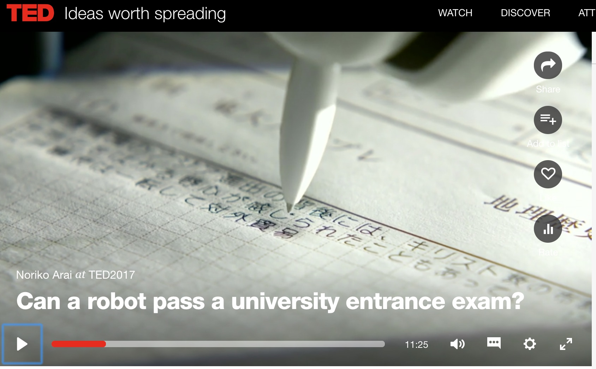
Can a robot pass a university entrance exam? Noriko Arai at TED2017
https://www.ted.com/talks/noriko_arai_can_a_robot_pass_a_university_entrance_exam
https://www.youtube.com/watch?v=XQZjkPyJ8KU

Slide 30
Machine Learning (ML) / Deep Learning (DL)
Decision Tree Classifiers
Support Vector Machine (SVM)
Supervised Learning
Neural Network (NN)
Linear Classifiers
Deep Learning (DL)
Machine Learning
(ML)
Rule-based Classifiers
Naïve Bayes (NB)
Unsupervised Learning
Probabilistic Classifiers
Bayesian Network (BN)
Maximum Entropy (ME)
Reinforcement Learning
Source: Jesus Serrano-Guerrero, Jose A. Olivas, Francisco P. Romero, and Enrique Herrera-Viedma (2015), "Sentiment analysis: A review and comparative analysis of web services," Information Sciences, 311, pp. 18-38.

Slide 31
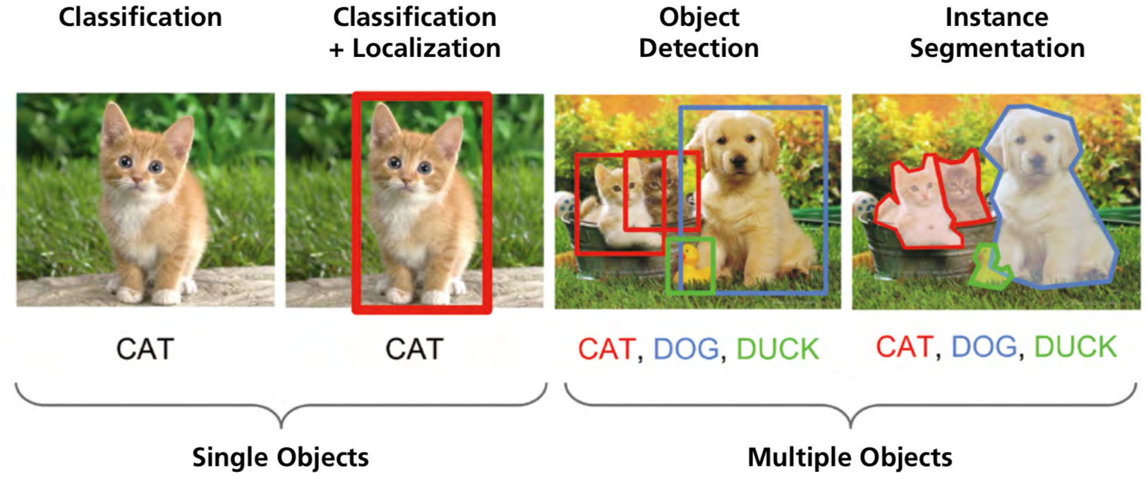
Computer Vision: Image Classification, Object Detection, Object Instance Segmentation
Source: DHL (2018), Artificial Intelligence in Logistics, http://www.globalhha.com/doclib/data/upload/doc_con/5e50c53c5bf67.pdf/

Slide 32
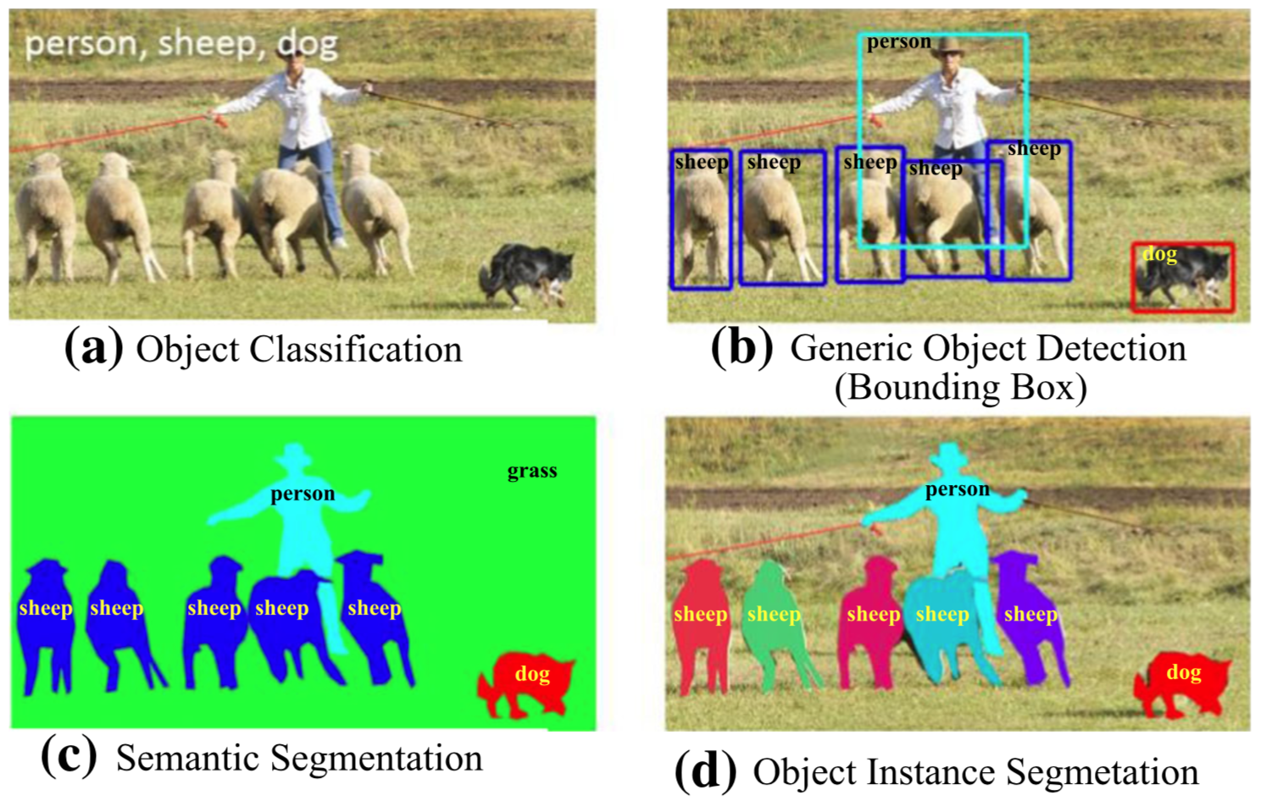
Computer Vision: Object Detection
Source: Li Liu, Wanli Ouyang, Xiaogang Wang, Paul Fieguth, Jie Chen, Xinwang Liu, and Matti Pietikäinen. "Deep learning for generic object detection: A survey." International journal of computer vision 128, no. 2 (2020): 261-318.

Slide 33
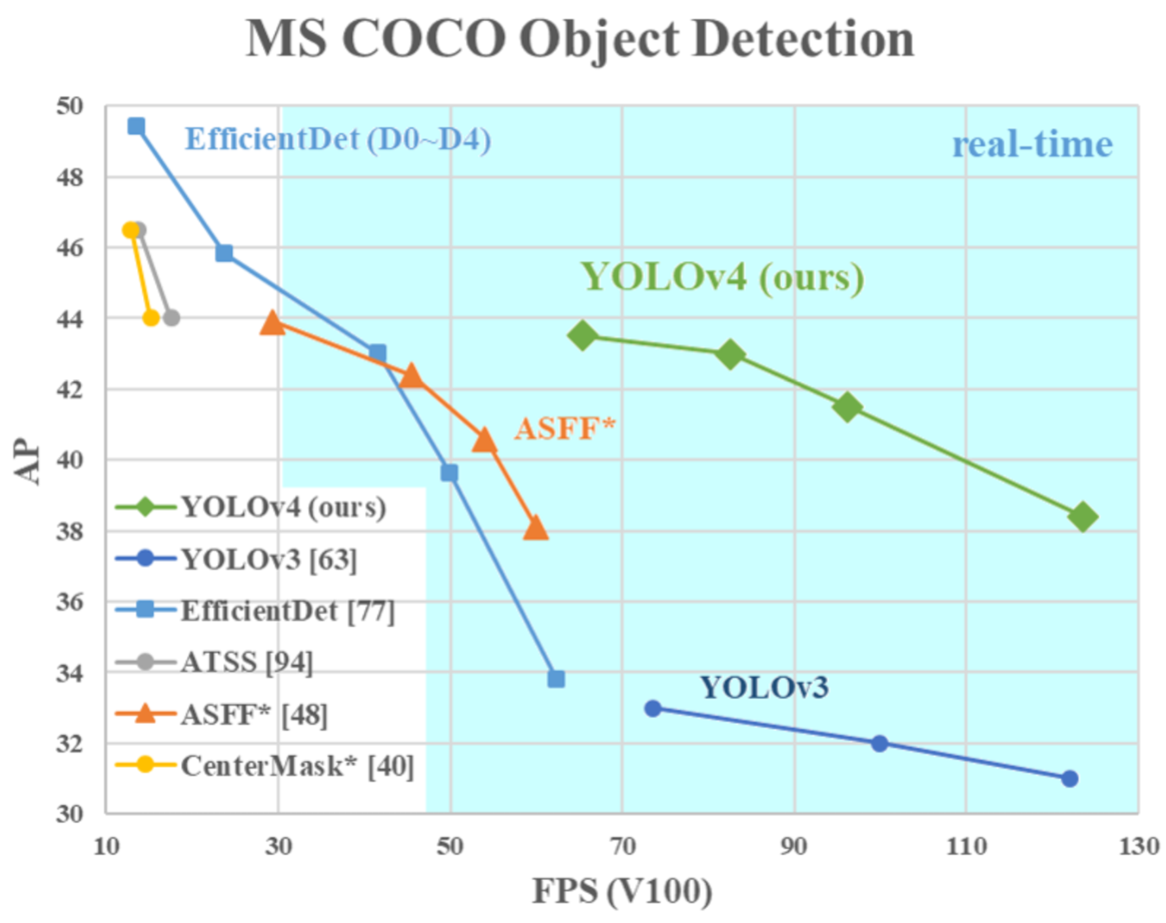
YOLOv4: Optimal Speed and Accuracy of Object Detection
Source: Alexey Bochkovskiy, Chien-Yao Wang, and Hong-Yuan Mark Liao. "YOLOv4: Optimal Speed and Accuracy of Object Detection." arXiv preprint arXiv:2004.10934 (2020).

Slide 34
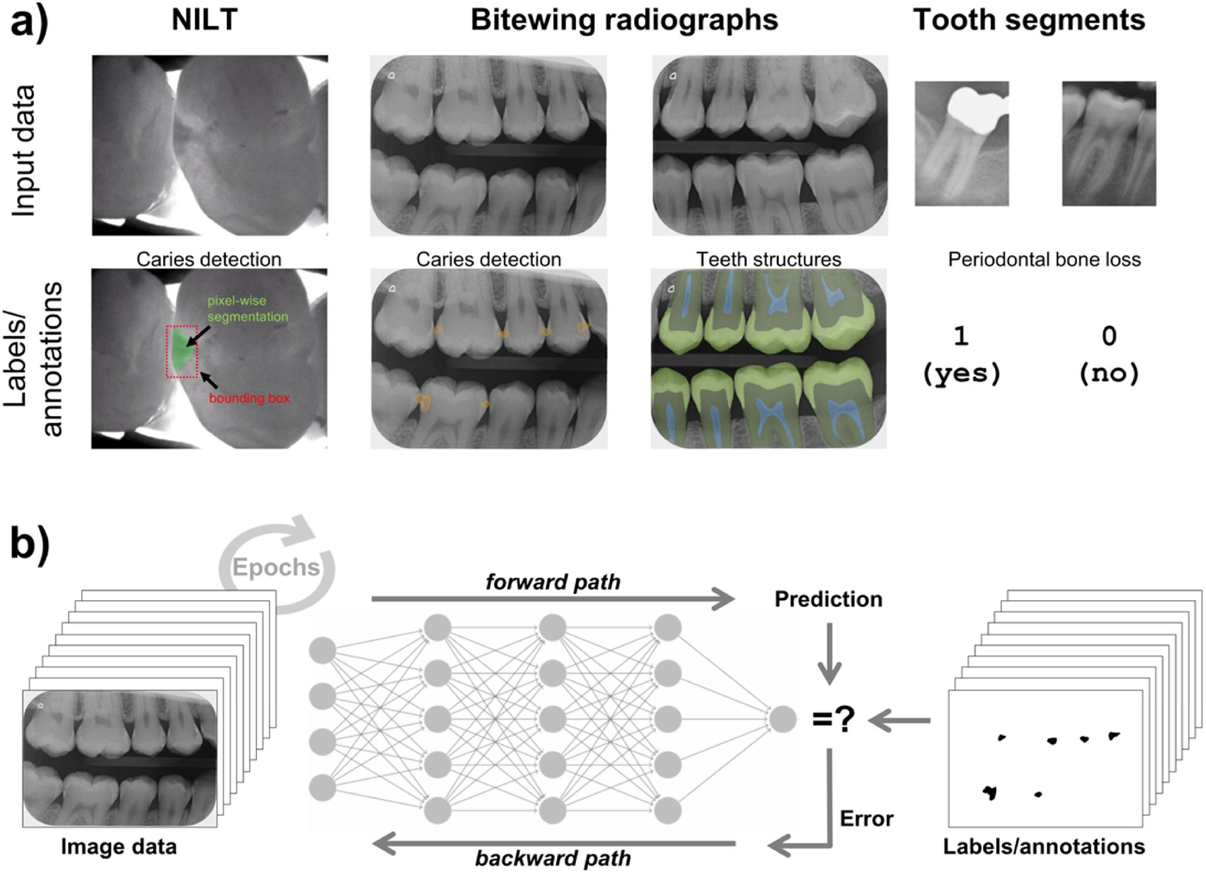
Labelling strategies for different dental image modalities
Near Infrared-Light Transillumination
Source: Falk Schwendicke, Tatiana Golla, Martin Dreher, and Joachim Krois (2019). "Convolutional neural networks for dental image diagnostics: A scoping review." Journal of Dentistry 91 (2019): 103226.

Slide 35
Scope and Performance of Artificial Intelligence Technology in Orthodontic Diagnosis, Treatment Planning, and Clinical Decision-making – A Systematic Review Journal of Dental Sciences (2020)
Source: Sanjeev B. Khanagar, Ali Al-Ehaideb, Satish Vishwanathaiah, Prabhadevi C. Maganur, Shankargouda Patil, Sachin Naik, Hosam A. Baeshen, and Sachin S. Sarode (2020). "Scope and performance of artificial intelligence technology in orthodontic diagnosis, treatment planning, and clinical decision-making-A systematic review." Journal of Dental Sciences.

Slide 36
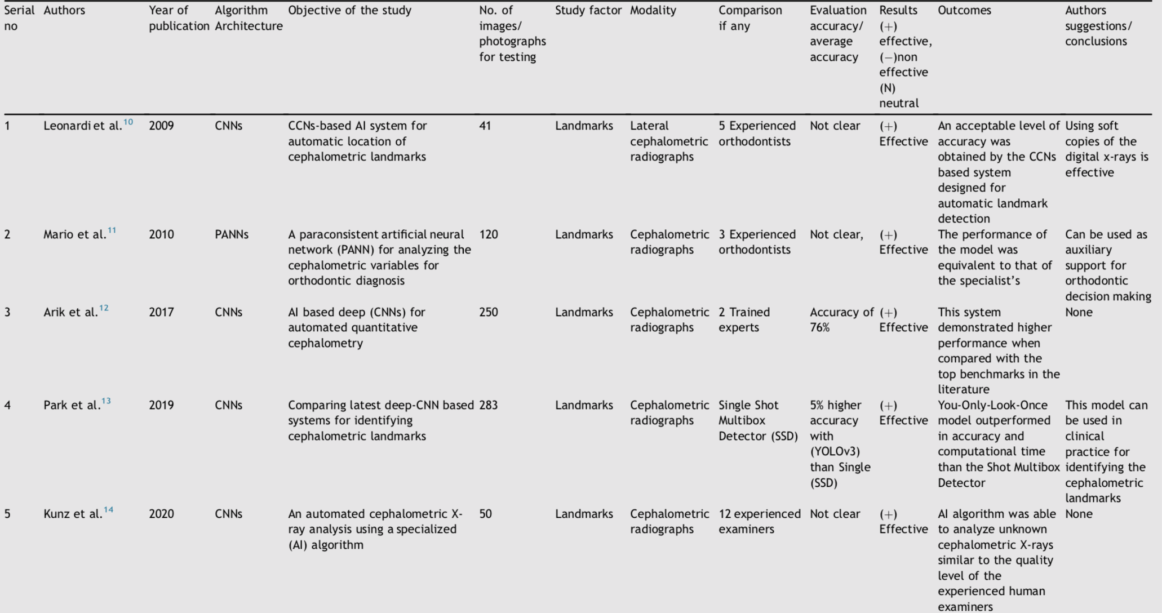
Artificial Intelligence Technology in Orthodontic Diagnosis, Treatment Planning, and Clinical Decision-Making
Source: Sanjeev B. Khanagar, Ali Al-Ehaideb, Satish Vishwanathaiah, Prabhadevi C. Maganur, Shankargouda Patil, Sachin Naik, Hosam A. Baeshen, and Sachin S. Sarode (2020). "Scope and performance of artificial intelligence technology in orthodontic diagnosis, treatment planning, and clinical decision-making-A systematic review." Journal of Dental Sciences.

Slide 37
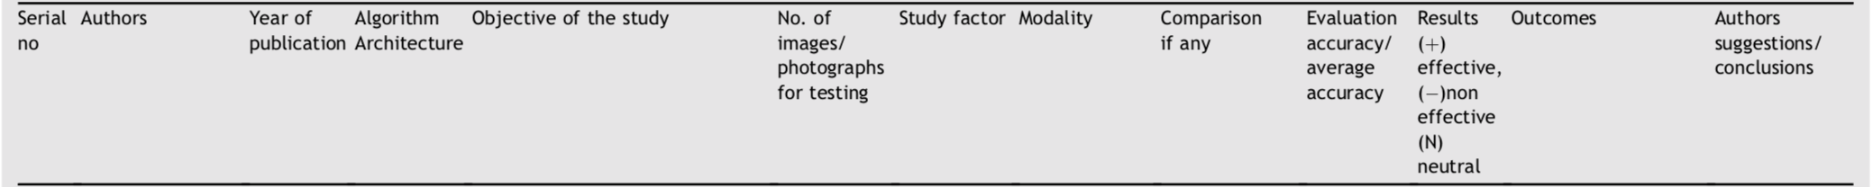
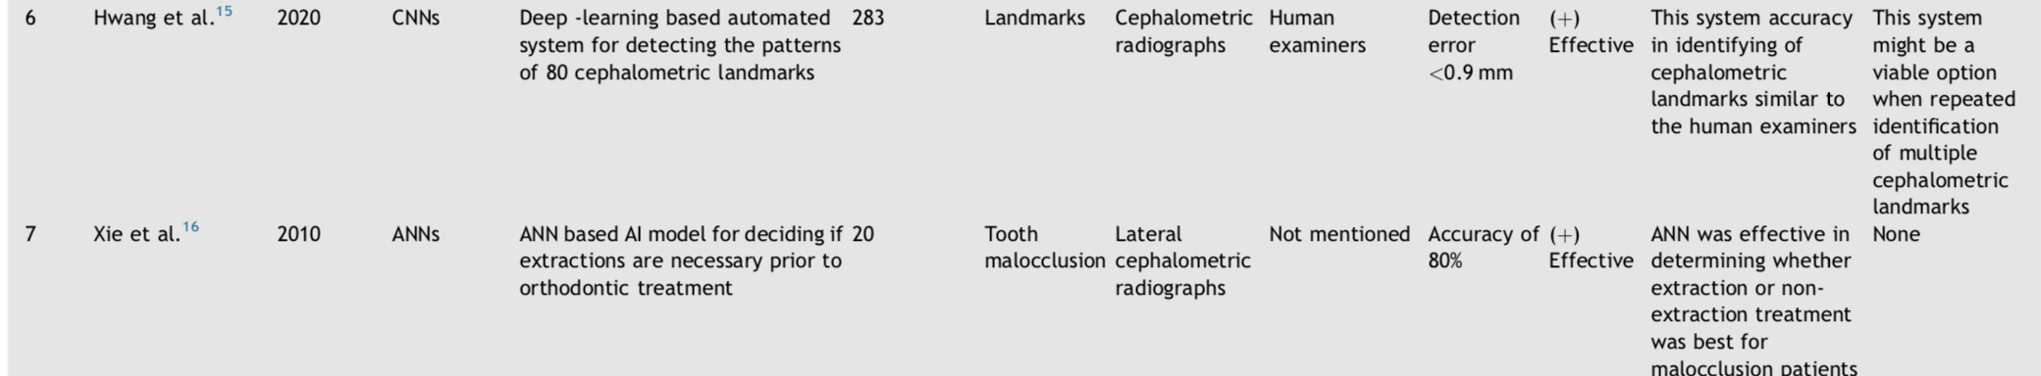
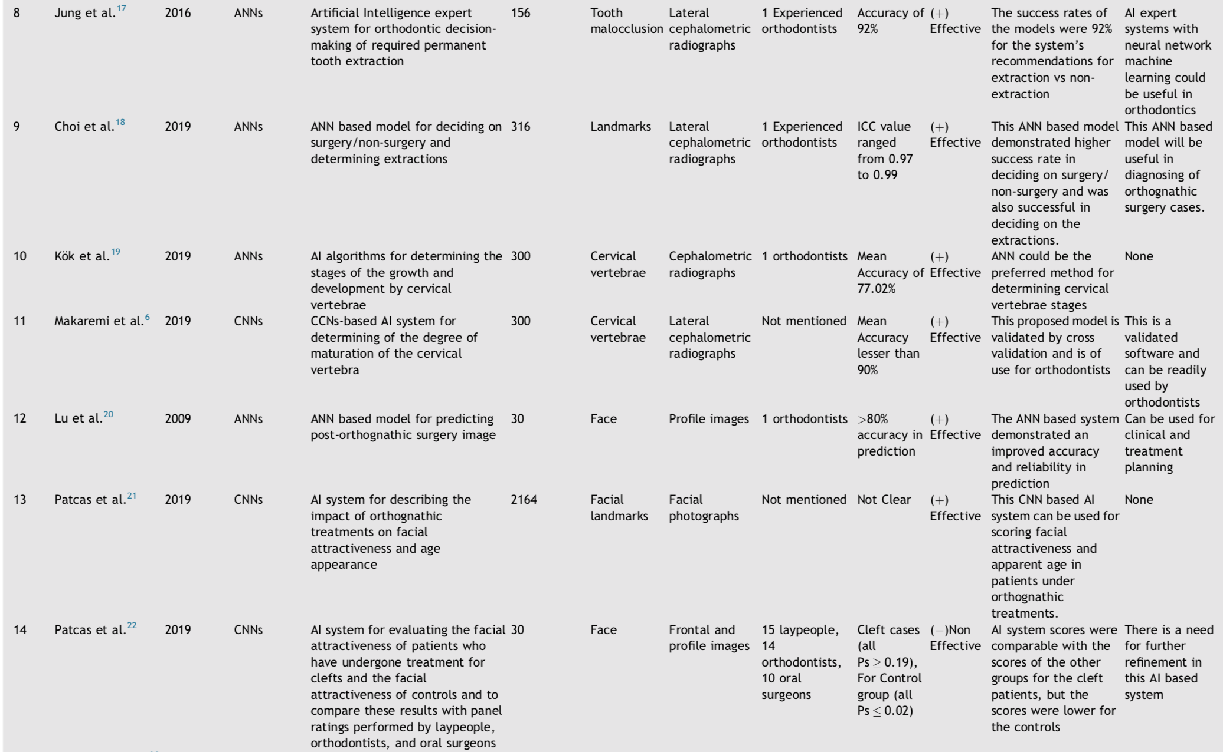
Artificial Intelligence Technology in Orthodontic Diagnosis, Treatment Planning, and Clinical Decision-Making
Source: Sanjeev B. Khanagar, Ali Al-Ehaideb, Satish Vishwanathaiah, Prabhadevi C. Maganur, Shankargouda Patil, Sachin Naik, Hosam A. Baeshen, and Sachin S. Sarode (2020). "Scope and performance of artificial intelligence technology in orthodontic diagnosis, treatment planning, and clinical decision-making-A systematic review." Journal of Dental Sciences.

Slide 38
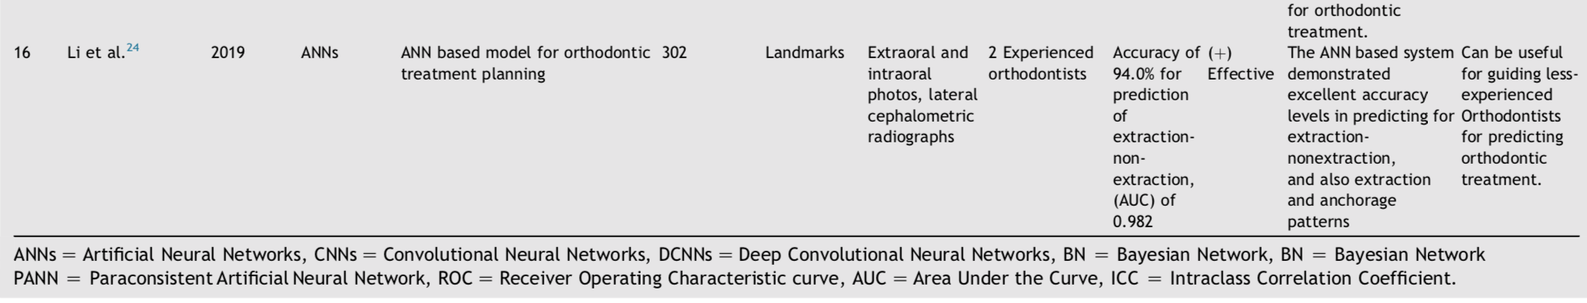
Artificial Intelligence Technology in Orthodontic Diagnosis, Treatment Planning, and Clinical Decision-Making
Source: Sanjeev B. Khanagar, Ali Al-Ehaideb, Satish Vishwanathaiah, Prabhadevi C. Maganur, Shankargouda Patil, Sachin Naik, Hosam A. Baeshen, and Sachin S. Sarode (2020). "Scope and performance of artificial intelligence technology in orthodontic diagnosis, treatment planning, and clinical decision-making-A systematic review." Journal of Dental Sciences.

Slide 39
Artificial Intelligence Technology in Orthodontic Diagnosis, Treatment Planning, and Clinical Decision-Making
Source: Sanjeev B. Khanagar, Ali Al-Ehaideb, Satish Vishwanathaiah, Prabhadevi C. Maganur, Shankargouda Patil, Sachin Naik, Hosam A. Baeshen, and Sachin S. Sarode (2020). "Scope and performance of artificial intelligence technology in orthodontic diagnosis, treatment planning, and clinical decision-making-A systematic review." Journal of Dental Sciences.

Slide 40
Comparing latest deep-CNN based systems for identifying cephalometric landmarks (Park et al., 2019)
CNNs
Comparing latest deep-CNN based systems for identifying cephalometric landmarks
283
Landmarks
Cephalometric radiographs
Single Shot Multibox Detector (SSD)
5% higher accuracy with (YOLOv3) than Single (SSD)
(+)Effective
You-Only-Look-Once model outperformed in accuracy and computational time than the Shot Multibox Detector
This model can be used in clinical practice for identifying the cephalometric landmarks
Source: Sanjeev B. Khanagar, Ali Al-Ehaideb, Satish Vishwanathaiah, Prabhadevi C. Maganur, Shankargouda Patil, Sachin Naik, Hosam A. Baeshen, and Sachin S. Sarode (2020). "Scope and performance of artificial intelligence technology in orthodontic diagnosis, treatment planning, and clinical decision-making-A systematic review." Journal of Dental Sciences.

Slide 41
Summary
Artificial Intelligence
Machine Learning
Deep Learning
AI in Oral Health Applications

Slide 42
References
Stuart Russell and Peter Norvig (2020), Artificial Intelligence: A Modern Approach, 4th Edition, Pearson
Eric Topol (2019), Deep Medicine: How Artificial Intelligence Can Make Healthcare Human Again, Basic Books
Tom Lawry (2020), AI in Health: A Leader’s Guide to Winning in the New Age of Intelligent Health Systems, HIMSS Publishing
Ramesh Sharda, Dursun Delen, and Efraim Turban (2017), Business Intelligence, Analytics, and Data Science: A Managerial Perspective, 4th Edition, Pearson.
Jared Dean (2014), Big Data, Data Mining, and Machine Learning: Value Creation for Business Leaders and Practitioners, Wiley.
Mehmet Kaya, Jalal Kawash, Suheil Khoury, and Min-Yuh Day (2018), Social Network Based Big Data Analysis and Applications, Lecture Notes in Social Networks, Springer International Publishing.
Varun Grover, Roger HL Chiang, Ting-Peng Liang, and Dongsong Zhang (2018), "Creating Strategic Business Value from Big Data Analytics: A Research Framework", Journal of Management Information Systems, 35, no. 2, pp. 388-423.
Ting-Peng Liang and Yu-Hsi Liu (2018), "Research Landscape of Business Intelligence and Big Data analytics: A bibliometrics study”, Expert Systems with Applications, 111, no. 30, pp. 2-10.
Javier Mata, Ignacio de Miguel, Ramón J. Durán, Noemí Merayo, Sandeep Kumar Singh, Admela Jukan, and Mohit Chamania (2018), "Artificial intelligence (AI) methods in optical networks: A comprehensive survey", Optical Switching and Networking, 28, pp. 43-57
Stephan Kudyba (2014), Big Data, Mining, and Analytics: Components of Strategic Decision Making, Auerbach Publications
Falk Schwendicke, Tatiana Golla, Martin Dreher, and Joachim Krois (2019). "Convolutional neural networks for dental image diagnostics: A scoping review." Journal of Dentistry 91 (2019): 103226.
Vivek Kaul, Sarah Enslin, and Seth A. Gross (2020), "The history of artificial intelligence in medicine." Gastrointestinal endoscopy.
Sanjeev B. Khanagar, Ali Al-Ehaideb, Satish Vishwanathaiah, Prabhadevi C. Maganur, Shankargouda Patil, Sachin Naik, Hosam A. Baeshen, and Sachin S. Sarode (2020). "Scope and performance of artificial intelligence technology in orthodontic diagnosis, treatment planning, and clinical decision-making-A systematic review." Journal of Dental Sciences.

Slide 43
Q & A
人工智慧於口腔健康應用 (Artificial Intelligence in Oral Health Applications)
臺北醫學大學 口腔衛生學系 人工智慧講座
Host: Prof. Li Sheng Chen School of Oral Hygiene, Taipei Medical University
Time: 15:10-17:00, Nov 23, 2020 (Monday)
Place: 口腔3樓會議室, TMU
Address: N250 Wu-Hsing Street, Taipei, Taiwan
Min-Yuh Day
戴敏育
Associate Professor
副教授
Institute of Information Management, National Taipei University
國立臺北大學 資訊管理研究所
https://web.ntpu.edu.tw/~myday
2020-11-23

